Slide 1
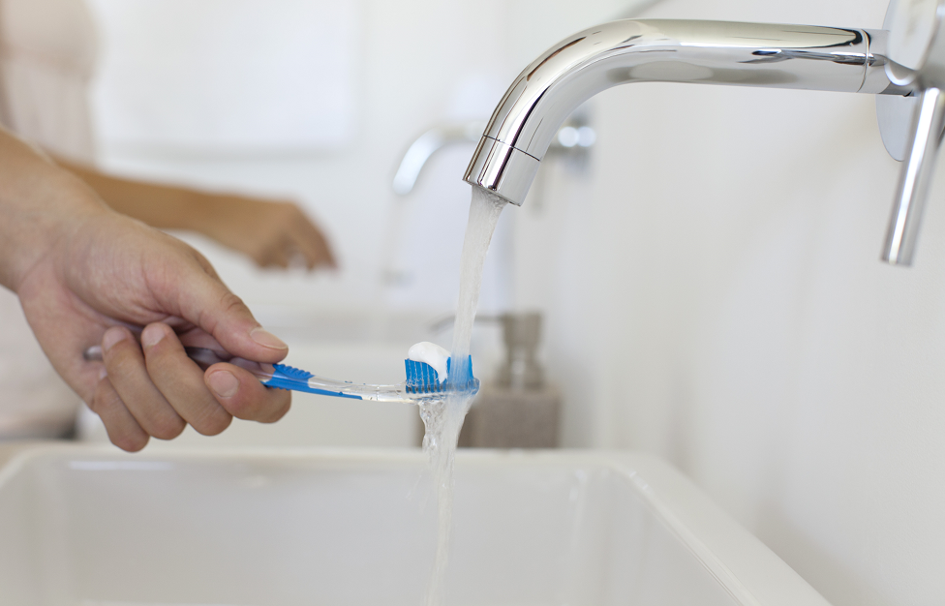
Dental PPO Plan
9126722 5/19 19-12448

Slide 2
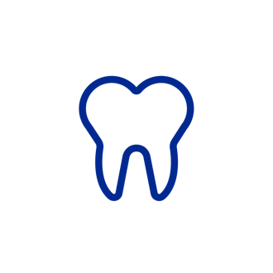
Dental PPO
Get to know your dental plan.
With this plan, you can see any dentist you want, anywhere across the country. When you choose a dentist who is part of your plan’s large national network, you may receive discounted rates only available to members. If you need to see a specialist, work with your primary care dentist.
Preventive care.
As long as you see a network dentist, your plan covers preventive services, including routine exams and cleanings, at little or no cost to you. You can get two cleanings in a 12-month period — one every six months.
Extra dental visits when you’re pregnant.
Increased bacteria levels in a pregnant woman’s mouth can lead to tooth decay. Your plan covers extra visits for cleanings and gum treatments when you’re pregnant, as recommended by your dentist. Be sure to include the name of your OB/GYN and your pregnancy due date on submitted claims.
Large National Network
See any network dentist to receive discounted rates. And there’s no need to get referrals to see a specialist.
Fillings, crowns and more.
When you see a network dentist, your plan covers fillings and may cover procedures, such as crowns and bridges. Some plans only cover silver fillings for back teeth. If you choose white fillings, you may need to pay the difference.
Cosmetic procedures are not covered.

Slide 3
About your plan
Deductible
For services other than preventive care, you may have to pay a deductible—a set dollar amount—before your coverage kicks in.
Cost sharing
Your dental plan benefits begin as soon as you meet the deductible. After that, you and your plan will share the costs of the services you receive. (This is known as coinsurance, the percentage of costs you pay for covered dental care after you’ve paid your deductible.)
Annual maximum
Your plan pays for services up to a set dollar amount, called an annual maximum. Preventive services, including routine dental checkups, may count toward your annual maximum. If you reach the maximum amount, you’ll need to pay the entire cost of any additional dental care you receive that year. Find your annual maximum on myuhc.com or call customer care.
Pre-treatment estimates
If you’re planning to have a procedure that may cost more than $500, ask your dentist to send UnitedHealthcare x-rays and notes about your condition. We will review the treatment to make sure it’s medically necessary. (The plan doesn’t cover unnecessary procedures.) After the review, your dentist will receive an estimate of what the plan will pay and what your out-of-pocket costs will be.
Out-of-network services
If you use a dentist outside the network, you may need to pay the difference between what the plan covers and what your dentist charges for the services. Plus, you may need to submit your own claims.

Slide 4
Benefits at a Glance
Dental Services | Plan 1 – 8X896 |  | Plan 2 – 8X897
 | In Network | Out of Network | In Network | Out of Network
Preventive and Diagnostic | 100% | 100% | 100% | 100%
Basic Services
Minor Restorative | 80% | 60% | 80% | 80%
Single Extractions | 80% | 60% | 80% | 80%
Endodontics | 80% | 60% | 80% | 80%
Periodontics | 80% | 60% | 80% | 80%
Major Services
Crown and Bridge | 50% | 50% | 50% | 50%
Dentures | 50% | 50% | 50% | 50%
Annual Deductible (Individual/Family) | $50/$150 In and Out of Network |  | $50/$150 In and Out of Network
Annual Maximum | $1500 per person per Calendar Year: In Network $1000 per person per Calendar Year: Out of Network |  | $1500 per person per Calendar Year

Slide 5
UnitedHealthcare Dental
SmileDirectClub is now covered by UnitedHealthcare dental plans.
Members can get a confident smile at a lower cost. SmileDirectClub helps members straighten teeth with clear aligners sent right to their door — in most cases, for less than $1,000² — with the help of their dental plan’s orthodontic benefit.
As part of this exclusive benefit, members can look forward to:
A free 3D digital image at one of 235 SmileShops or an at-home impression kit ($0 cost with rebate).
A free retainer following completion of their smile journey ($0 cost with subscription).
bright on™ premium teeth whitening ($0 cost).
A smile they’ll love in about 6 months on average.³
UnitedHealthcare is among the first to cover SmileDirectClub in the network. SmileDirectClub is a leader in doctor-directed, at-home teeth straightening with clear aligners.
²
¹ SmileDirectClub is available to members enrolled in a UnitedHealthcare Dental Preferred Provider Organization (PPO) plan that includes orthodontic coverage. Not all individuals are suitable candidates for clear aligners. These services are intended for certain individuals who have mild or moderate orthodontic needs.
² Cost of less than $1,000 is based on a UnitedHealthcare national dental plan design for employee-only coverage with a 50 percent orthodontic benefit.
³ SmileDirectClub treatment plan average results, 2018.

Slide 6
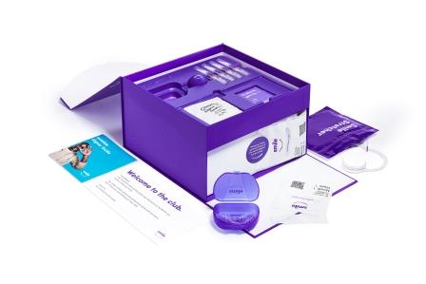
UnitedHealthcare Dental
Here’s how much members might save.
A lower-cost way to straighten teeth.
With SmileDirectClub, qualified members may potentially see significant savings and convenience.
.
SmileDirectClub cost | $1,850
UnitedHealthcare network discount | - $200
Your dental plan pays (if orthodontic coverage is 50%)* | - $825
Members could only pay | $825
A straighter, brighter smile can help bring your employees a lifetime of confidence. It also gives them more reason to enjoy your benefits package.
* For illustrative purposes. Savings may differ based on your plan’s orthodontic coverage and your location.

Slide 7
Myuhc.com
Make the most of your dental plan.
As a member, you can see your plan details, check your claims and learn about oral health on myuhc.com.
Find a network dentist.
Finding a network dentist is easy. You have two options:
Log in to myuhc.com and use the Find a Dentist tool to search by name, facility or location. You’ll see a list of dentists who are part of your network.
Call the customer care number on your ID card.
Use your dental ID card.
All members receive an ID card. Your card only lists the name of the person who signed up for the plan, but everyone covered by your plan should use the card. Be sure to bring it with you each time you see the dentist.
Print your ID card anytime at myuhc.com.
Estimate your costs.
Use the dental cost calculator on myuhc.com to calculate your out-of-pocket costs ahead of time.
7

